Slide 1
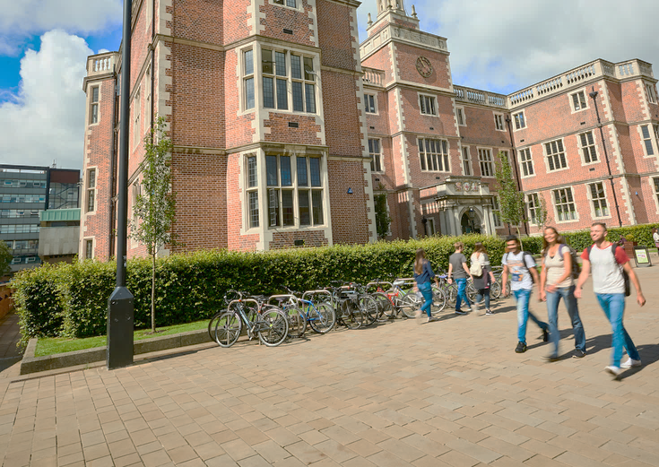
Newcastle University Finances
Summary for Students
2022/23
From Newcastle. For the world.
Notes:
FIXED Image / Presentation title slide.
Insert title and sub-deck as required to start your presentation.
`1234567890-=qwertyuiop[]asdfghjkl;’#\zxcvbnm,./
¬!”£$%^&*()_+QWERTYUIOP{}ASDFGHJKL:@~|ZXCVBNM<>?

Slide 2
Introduction
Newcastle University is one of the largest universities in the UK. Our total income in 2022/23 was £608 million (see slide 5 for income detail).
This summary aims to demonstrate where our income comes from and how we use that money to pay our staff, provide financial and well-being support to students and cover all other costs required to keep the University running and in good shape for the future.
The information is prepared using a template developed by Universities UK so all universities provide information on a consistent basis. If you want to know more then please follow this link to access our Integrated Annual Report and Financial Statements.
Our expenditure in 2022/23 was £604 million meaning we achieved a surplus of £4 million on our operating activities. Additionally, there was a £31 million reduction in the University’s pension liability and a loss of £5m on impaired assets resulting in an overall statutory surplus position after tax of £30m .
As a “not for profit” charity the University does not pay dividends to shareholders. Any surplus is re-invested for future improvements.
Notes:
EDITABLE text/image slide.
To add an image, click on image icon and select from your files, or drag it into place. Please note: there are a selection of images cropped for this exact size on the University image library photo http://photolib.ncl.ac.uk/asset-bank/action/browseItems?categoryId=3578&categoryTypeId=1

Slide 3
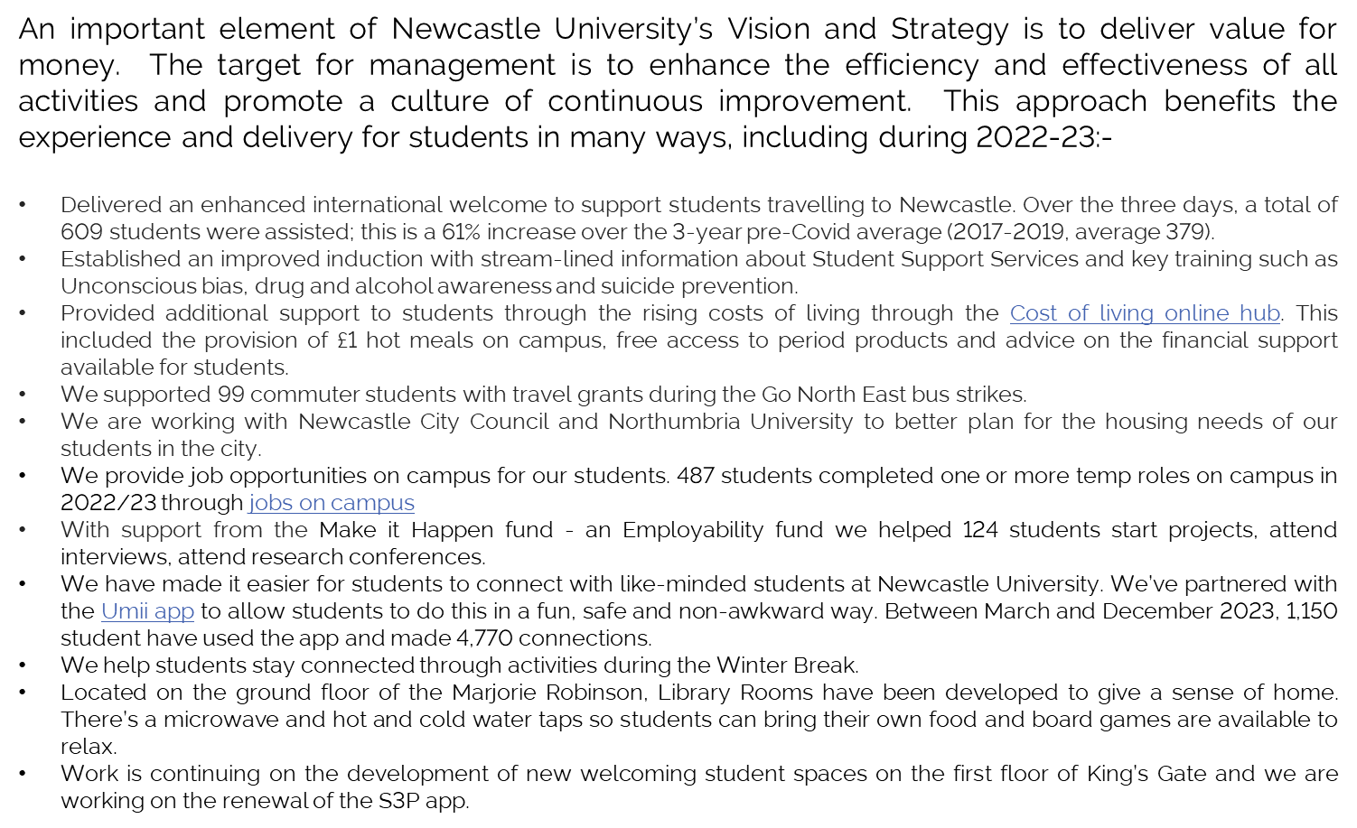
Value for money

Slide 4
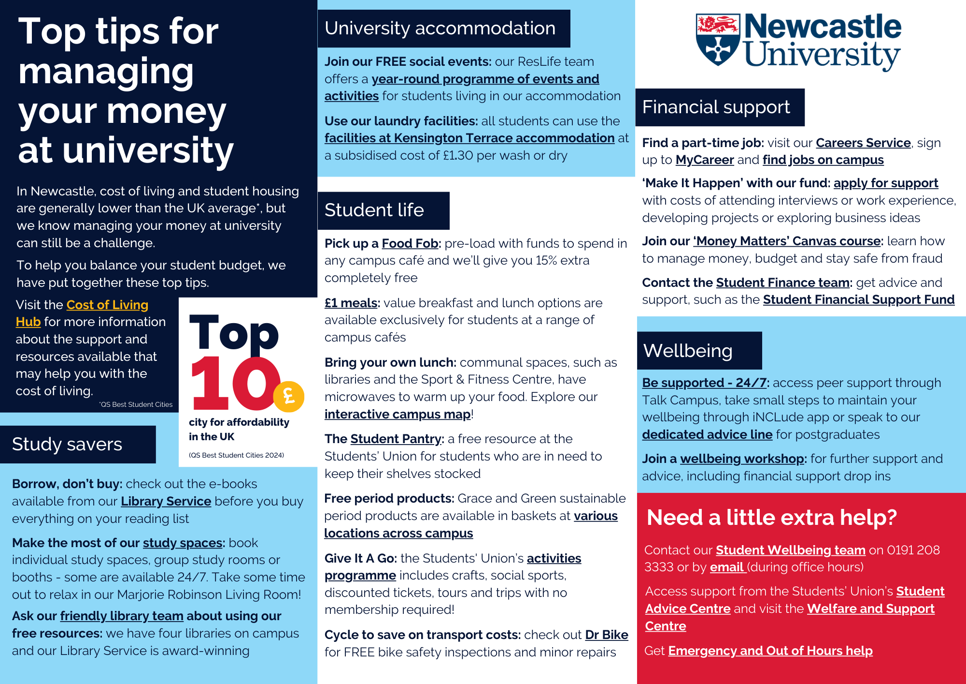
Support and Advice

Slide 5
Where our income comes from
We draw on a variety of income sources to support our work, including government grants, student fees, donations and self generated income through commercial activities.
This chart shows the main sources of income in 2022-23. Student fees, in total, made up about 50% of our income.
Notes:
EDITABLE text/image slide.
To add an image, click on image icon and select from your files, or drag it into place. Please note: there are a selection of images cropped for this exact size on the University image library photo http://photolib.ncl.ac.uk/asset-bank/action/browseItems?categoryId=3578&categoryTypeId=1

Slide 6
How we spend our income
This chart shows how we used our income in 2022/23 to support a wide range of activity including education, cutting-edge research, knowledge exchange and community engagement.
Ensuring research led teaching and learning excellence, a quality student experience and student outcome success are at the centre of everything we do at the University.
Notes:
EDITABLE text/image slide.
To add an image, click on image icon and select from your files, or drag it into place. Please note: there are a selection of images cropped for this exact size on the University image library photo http://photolib.ncl.ac.uk/asset-bank/action/browseItems?categoryId=3578&categoryTypeId=1

Slide 7
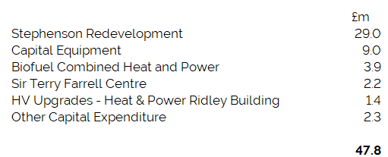
Investing for the future
Capital expenditure (investment in buildings, IT, and teaching and research facilities) is not included in costs illustrated in previous slides. They are funded from external grants (usually from Government),donations from benefactors and from surpluses made in prior years.
During 22-23 there was a £47.8m capital investment including significant projects such as the Stephenson engineering building redevelopment, which has opened its doors to students in Autumn 2023.
A high level breakdown of capital spending in the year is below.
Notes:
EDITABLE text/image slide.
To add an image, click on image icon and select from your files, or drag it into place. Please note: there are a selection of images cropped for this exact size on the University image library photo http://photolib.ncl.ac.uk/asset-bank/action/browseItems?categoryId=3578&categoryTypeId=1

Slide 8
Explaining the terminology
Income
Government grants: We receive grants from the Office for Students and UK Research and Innovation to support teaching high cost subjects (science, medicine etc.), to support the costs of our research activity, to help us with widening participation work and to help pay for some of our new buildings.
Research – other sources: This is the total of grants received from bodies, other than the UK Government, to support our research work including charities, business and the European Union.
Endowment and investment: Our cash balances in the bank earn interest and we receive donations and legacies from friends of the University to support key areas of research and student experience.
Intellectual property rights: Sometimes our research creates results which are valuable to others and they pay us for the rights to use our knowledge.
Other income: includes money we receive from the NHS for work that our clinical colleagues do in local hospitals, consultancy work for business, income from our farms, and many other smaller income streams.
Expenditure
Teaching and research: Support staff salaries include our laboratory technical and colleagues who work in School offices to support students and staff. Other costs include the day to day running costs of the schools and money they spend to undertake research work (which will be covered by research income from our funders).
Administration and central services: includes the costs of colleagues in Finance, People Services, IT, Estates, Corporate Affairs, Marketing, NU Advancement and the Executive Office.
Financial support to students and outreach: includes the costs of bursaries and scholarships which we provide to students: both undergraduate and postgraduate and the costs of the work we do to encourage local schoolchildren to want to progress to a University.
Student and staff facilities: Includes our financial support to NUSU and the costs of training and developing our staff
Maintaining campuses: The costs of heating, lighting, cleaning and maintaining our buildings as well as business rates paid to the local council and rent costs for buildings which we don’t own ourselves.
Accommodation and conferences: The costs of running our students accommodation and catering services which would usually be fully covered by the income we receive for those services.
Surplus/Deficit
In simple terms the surplus or deficit we achieve at the end of a financial year is the income we earn less expenditure incurred. We manage the University performance by a measure of operating surplus or deficit as this excluding one-off accounting adjustments and events outside of management control. Our statutory surplus or deficit includes all such entries over a reporting period.
Notes:
EDITABLE text/image slide.
To add an image, click on image icon and select from your files, or drag it into place. Please note: there are a selection of images cropped for this exact size on the University image library photo http://photolib.ncl.ac.uk/asset-bank/action/browseItems?categoryId=3578&categoryTypeId=1

